Slide 1
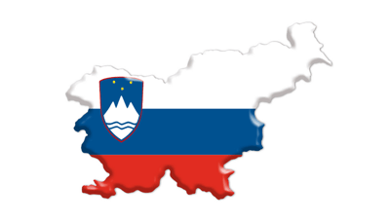
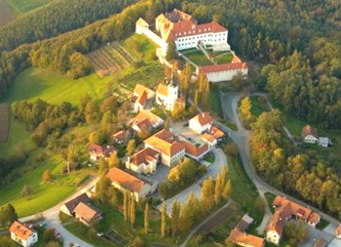
SLOVENIA
NEGOVA
OŠ dr. Antona Trstenjaka Negova, Slovenia

Slide 2
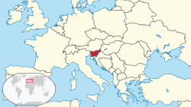
Official name: Republic of Slovenia
Capital city: Ljubljana
Population: 2 065 895 (2015)
Area: 20 273 km²
OŠ dr. Antona Trstenjaka Negova, Slovenia

Slide 3
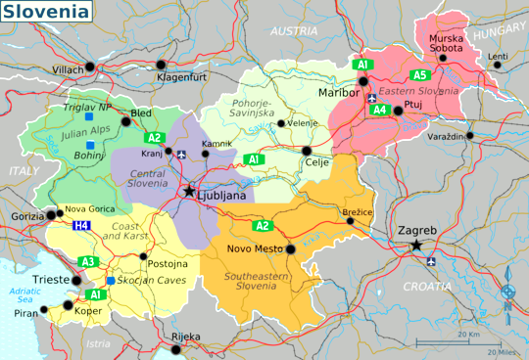
MAP OF SLOVENIA
OŠ dr. Antona Trstenjaka Negova, Slovenia

Slide 4
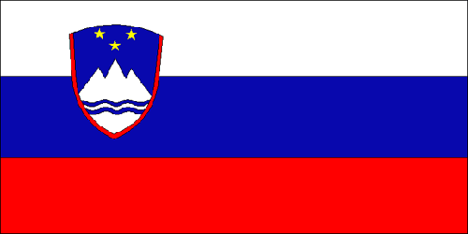
SLOVENIAN FLAG
Red, white and blue are traditional Pan-Slavic colors. The Slovenian coat of arms features three gold stars, said to be a symbol of the Duchy of Celje arms. The mountains shown in white represent the Alps, and the wavy blue lines across the bottom indicate Slovenia's valuable access to the sea. The Slovenian flag was officially adopted on June 24, 1991.
OŠ dr. Antona Trstenjaka Negova, Slovenia

Slide 5
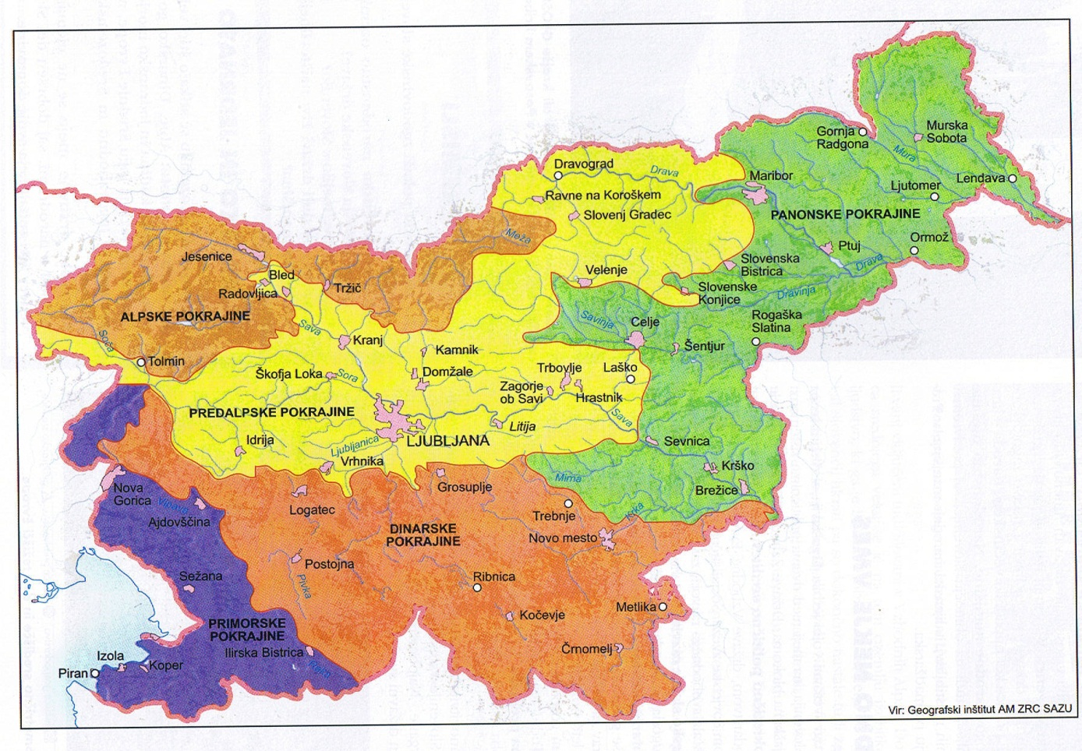
GEOGRAPHICAL DIVISION OF SLOVENIA
the Pannonian plain
the Alps
Subalpine
the Dinaric area
the Mediterranean
OŠ dr. Antona Trstenjaka Negova, Slovenia

Slide 6
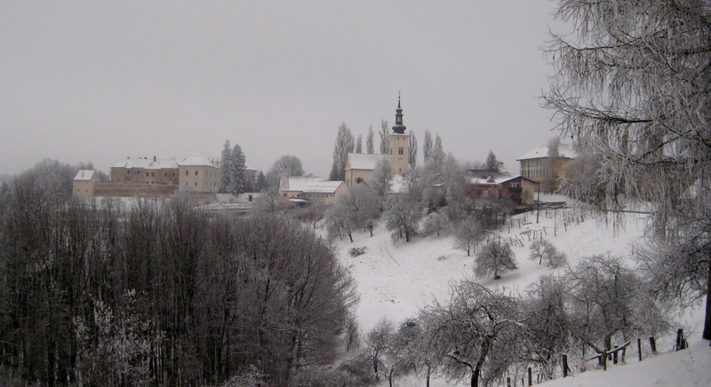
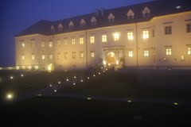
NEGOVA
Negova is a village in the hills to the west of Gornja Radgona in northeastern Slovenia.
Negova Castle is a castle immediately to the north of the main settlement. It is a complex of buildings that are 16th- and early 17th-century extensions of the original castle, built in 1425.
OŠ dr. Antona Trstenjaka Negova, Slovenia

Slide 7
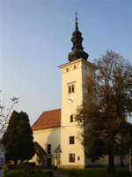
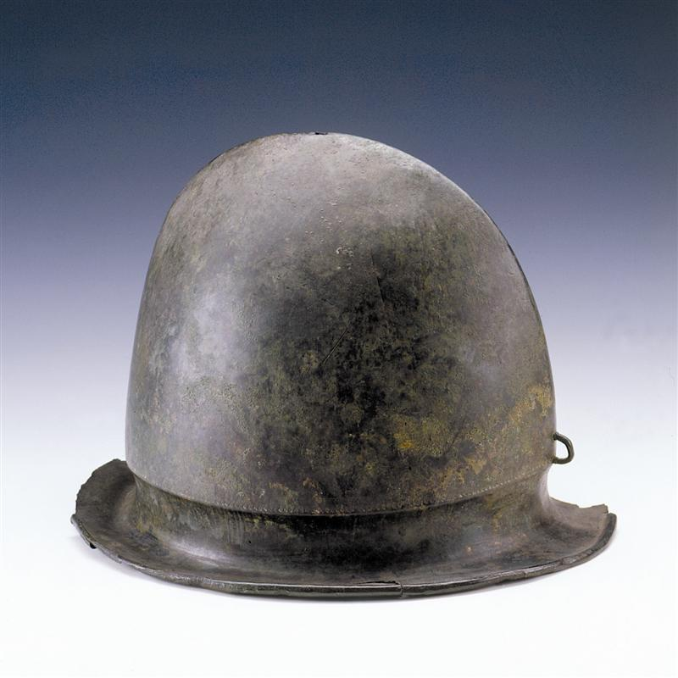
The parish church in the settlement is dedicated to the Nativity of Mary and belongs to the Roman Catholic Archdiocese of Maribor. It was originally a 16th-century Gothic building, but was rebuilt in 1710 and has 19th-century additions.
The Negau bronze helmet from the end of the Hallstatt – iron period in the time between 450-350 BC was found nearby.
OŠ dr. Antona Trstenjaka Negova, Slovenia

Slide 8
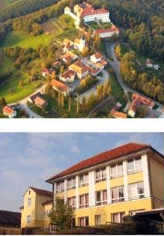
OUR SCHOOL
Name and address of school:
Primary school dr. Antona Trstenjaka Negova Negova 20 9245 Spodnji Ivanjci
Principal of the school: Slavica Trstenjak, M.sc.
Number of students: 102
Number of teachers: 23
Film
OŠ dr. Antona Trstenjaka Negova, Slovenia

Slide 9
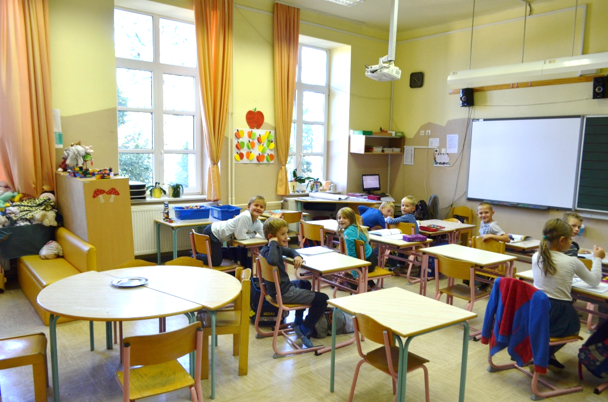
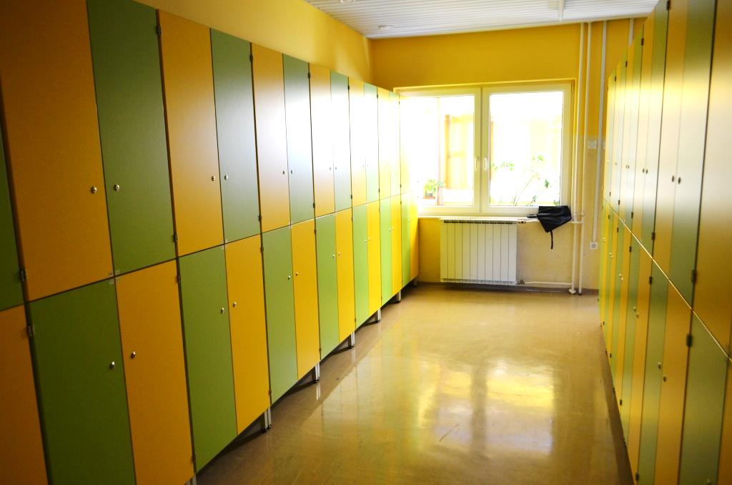
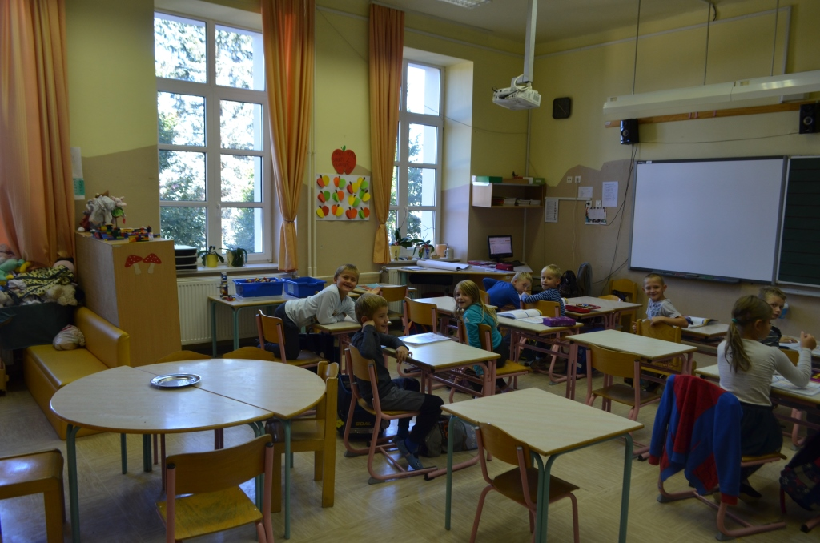
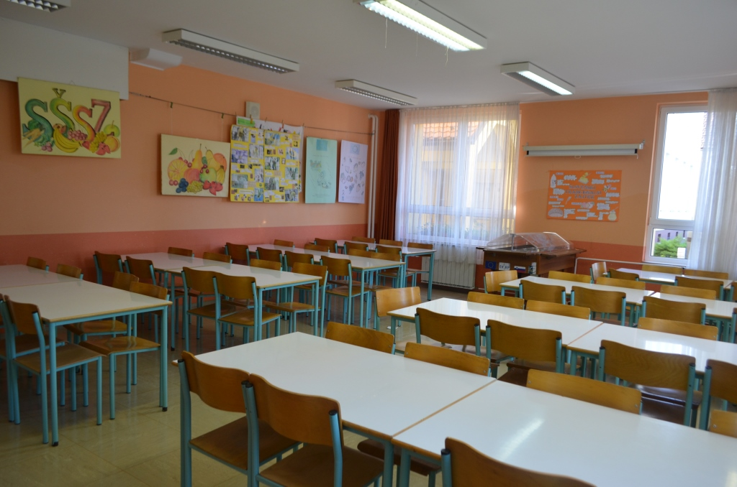
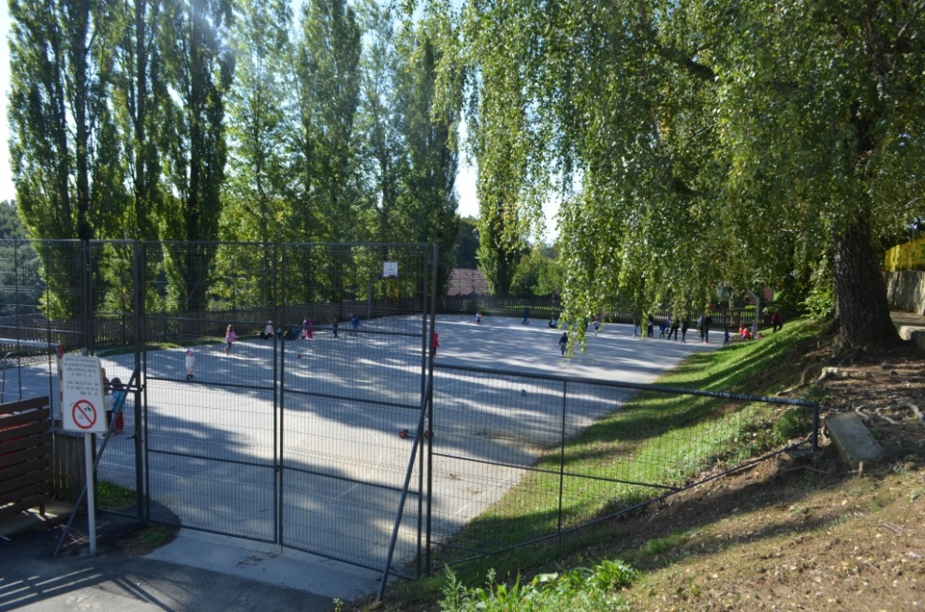
OŠ dr. Antona Trstenjaka Negova, Slovenia

Slide 10
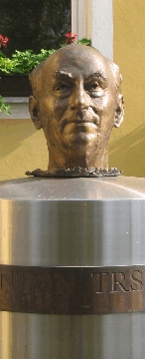
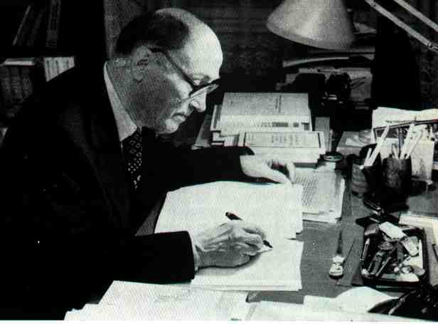
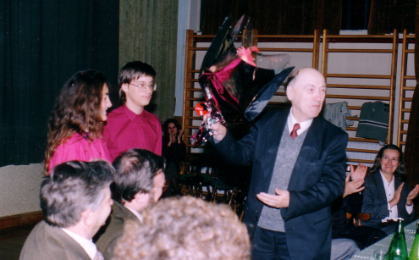
Anton Trstenjak, PhD (1906-1996)
OŠ dr. Antona Trstenjaka Negova, Slovenia

Slide 11
THE ORIGN OF THE NAME OF OUR SCHOOL
Our school is named after Anton Trstenjak, PhD (1906-1996) who was a pupil of our school in the years 1912-1918.
He was an excellent student and later a well-known psychologist, a theologian, a philosopher and author. He was also active in graphology.
He worked for the well-being of people and helped them in distress. In his works, a human is in the foreground.
He wrote 47 books, which are translated into many different languages; and more than 500 articles.
He told to the Slovenes to stick together, since we are a small nation. His words are engraved on his statue, standing in front of our school. Today we have a memorial room in the school.
OŠ dr. Antona Trstenjaka Negova, Slovenia

Slide 12
OŠ dr. Antona Trstenjaka Negova, Slovenia

